Slide 1
3.6: Low-Fidelity Prototyping: Paper & Sketches
Minal Bombatkar

Slide 2
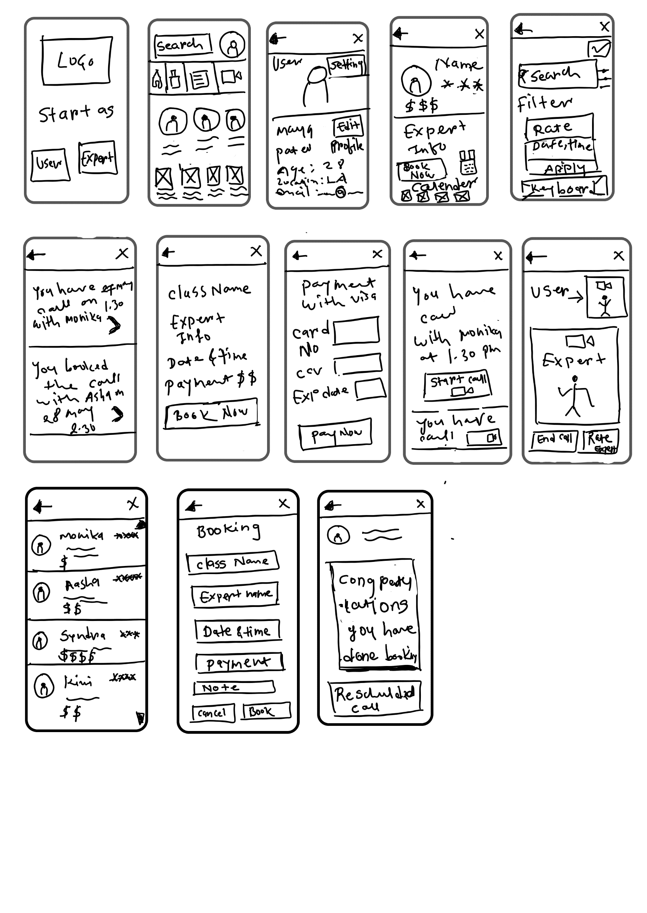

Search for yoga expert: Mobile
Home
Search yoga expert
Result for search
Yoga expert profile

Slide 3

Book the yoga expert: Mobile

Slide 4
Video call: Mobile
Home

Slide 5
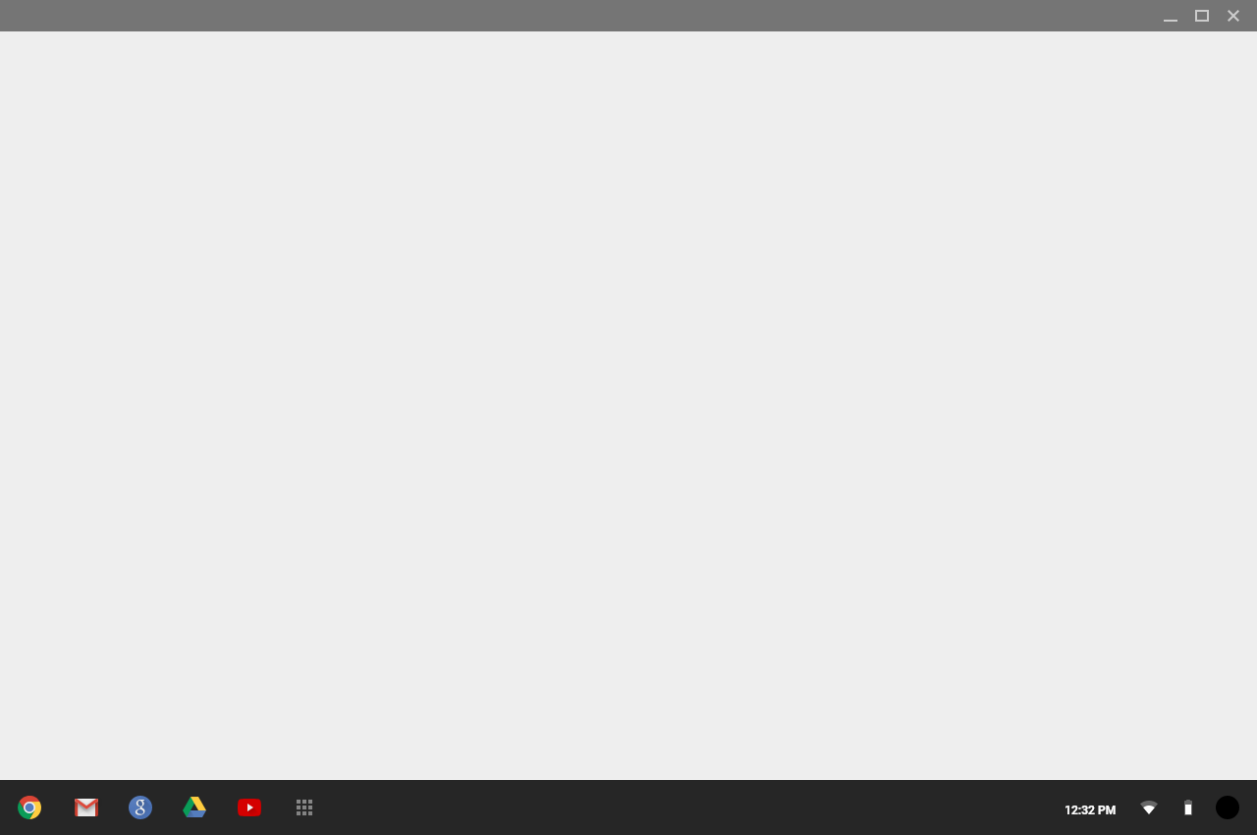
Search for yoga expert: Desktop
Home
Search yoga expert

Slide 6
Search for yoga expert: Desktop

Slide 7
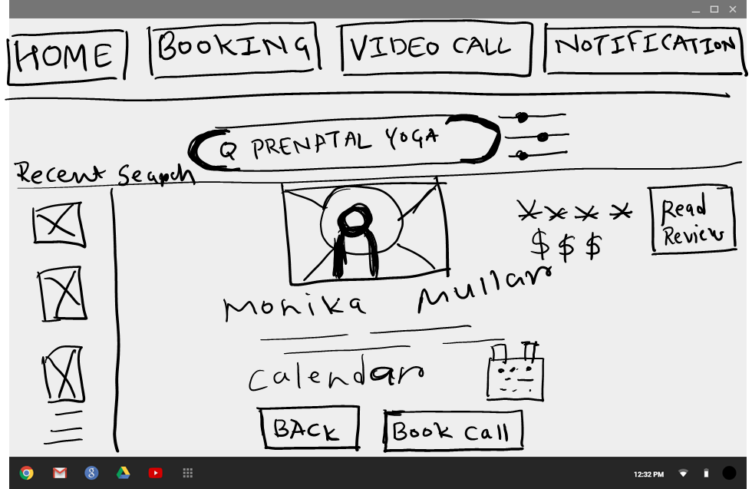
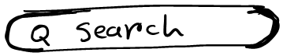
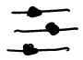
Book the yoga expert: Desktop

Slide 8


Slide 9
Video call: Desktop
Home

Slide 10
Video call: Desktop

